Slide 1

Interview Assignment Image Classification
Inbal Schekler

Slide 2
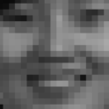
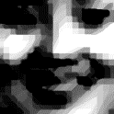
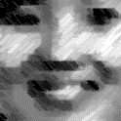
The final process
Input images
Augmentation
19 × 19 × 16
9 × 9 × 16
4 × 4 × 32
19 × 19 × 1
9 × 9 × 32
Output layer
64 × 1
Conv 3 × 3, Relu
Max pool 2 × 2
Dropout (0.2)

Slide 3
The way to the final process
1. This is a Classification problem, therefor I chose to use a CNN.
2. The images are small (19,19) so first I’ve built a CNN with 2 convolution layers, max-pooling and dropout.
3. The overall performance was good with a test accuracy of 98.27% but after looking carefully at the results, the high score was as a result of the biased data toward non-face (there were more images of non-face compare to face images). Eg: The recall was only 0.15 (out of 472 face images, only 75 was correctly predicted as faces).
4. In order to improve my results, first I wanted to try models with more learnable parameters. Therefor, I’ve built two models with more parameters by adding filters to the conv layers and by adding conv layers. This extra learnable parameters didn’t improve the model.

Slide 4
The way to the final process
5. Adding augmentation: because the model didn’t learn well to recognize face images, I thought that adding augmentation can help improving the model.
6. Adding the augmentation help improving the model significantly. The overall accuracy didn’t change a lot but the recall increased from 0.15 to 0.6.
7. I would try next to add pretrained models. I started doing it (not in the code I submitted) but because of the small dimension of the image and mainly because of it being grey scale, it demanded changing the dimensions of the VGG model, which is possible but demanded more than the time allocated for this assignment.

Slide 5
Final results
Test accuracy = 98.1%
Recall = 0.59
Precision = 0.51
AUC = 0.792

Slide 6
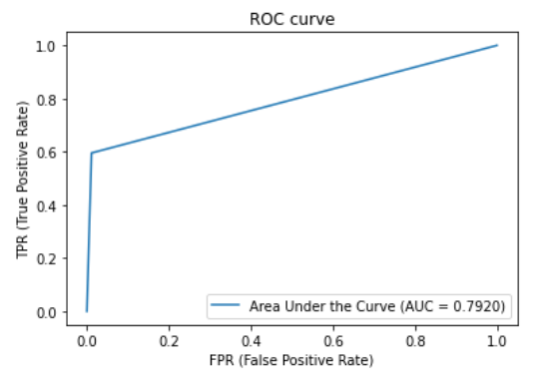
Analysis of mis-classification
Depend on the FPR (False Positive Rate) we want to allow the model to get, we can increase the TPR (True Positive rate).
If we are willing to have more non faces to be detected as faces, we will also be able to get higher percentage of correctly classified faces. It’s depend on the goal of our task.
Confusion matrix
True class
Face
Non-Face
Face
245 | 22883
23328 | 244
Predicted class
Non-Face

Slide 7
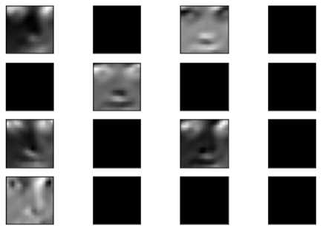
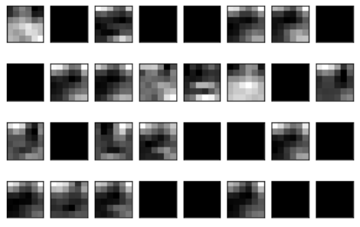

Computed features
First conv layer
Second conv layer

Slide 8
Further improvement of the model
My next steps would’ve been:
Using transfer learning: use features from pre trained models as VVG16
Helping the model to learn faces features better by increasing the size of train data of faces (as it is pretty easy to get images of faces).
Trying basic machine learning models as XGBoost. This is a classic classification problem so I don’t think it will improve the model but if I had no limit of time I would give it a try.

Slide 9
The code
Link to the code:
https://github.com/Inbal-Schekler/Jubaan_Interview/blob/main/Interview_assignment_Inbal_Schekler.ipynb

Slide 10
Using the model in a Python application
For using the model you need to:
1. Copy the model (I would save it in another file)
2. load the best epoch file with the command:
model.load_weights (‘the location of the saved epoch.hdf5’)
3. Pre-process the new images by scaling and resizing it to fit the model

